Slide 1

React-Native
Chase Moynihan and Miles McCloskey

Slide 2
What is React-Native?
Used to create mobile applications.
React Native is a javascript framework for building native mobile apps for android and iOS devices.
React applications are indistinguishable from applications created using objective-c or Java.

Slide 3
Advantages
JavaScript - Use existing JavaScript knowledge to your advantage
Community - Large community for troubleshooting and problem solving
Hot Reloading - Don’t need to recompile code
Can use API’s for device interaction (Fetch, Redux, React Navigation)
CameraRoll
Geolocation
Vibration
Share / Messages
PushNotifications

Slide 4
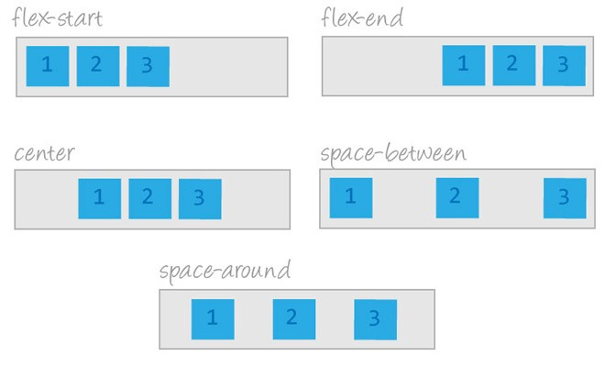
Features
Platforms- React-Native supports iOS and Android
Flexbox - Accommodate varying screen sizes by providing flexbox support
Native - can eject application out of React Native and continue Development natively
Can go from React Native app To Native app
Can publish to app store directly From React Native

Slide 5
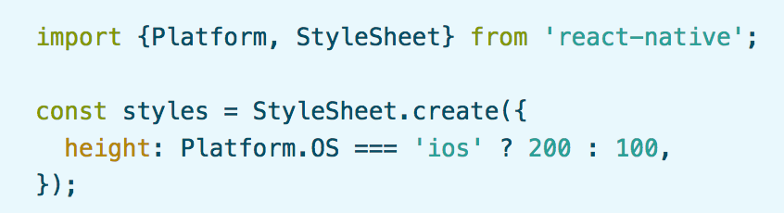
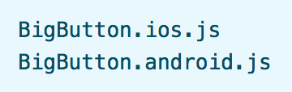
Platform Specific Code
React Native provides a way to organize your code and separate it by platform
Useful for cross-platform applications
Two ways to organize code by platform
Using the Platform module - when small parts are platform specific
Using platform specific file extensions - when platform specific code is complex

Slide 6
Integrate React-Native with Existing Applications
React Native can be used to add functionality to existing native applications
How to integrate React Native components into iOS application
Set up React Native dependencies & directory structure
Learn what React Native components you will be using
Add components & dependencies using CocoaPods
Develop your new React Native components
Add a RCTRootView to your iOS app (container for React Native component).
Start React Native server and run native application
Check that React Native portion of your application works properly

Slide 7
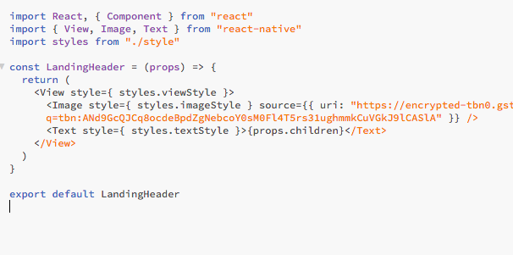
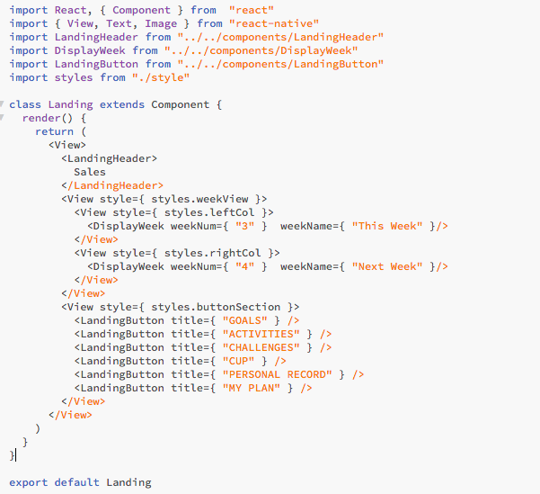
Props
A prop is immutable
A prop lets you create a single component that is used in many different places in the application.

Slide 8
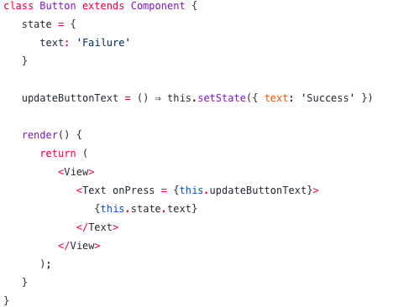
States
A State is mutable
State is nothing but a triggering method which is used to update values in the Component.
Notes:
Each time when ‘setState’ is called, the render() function in a Component will be called simultaneously.

Slide 9






Reactive Native Applications

Slide 10

Summary
What react native is
The advantages
Features
Platform specific code
integration with existing apps
Some code examples
Companies who use React Native

Slide 11
References
Android, T. (2017, November 04). Props and State in React Native – TakeOff Android – Medium. Retrieved May 9, 2018, from https://medium.com/@takeoffandroid/props-and-state-in-react-native-c61589bf4cda
Buna, S. (2017, March 30). Yes, React is taking over front-end development. The question is why. Retrieved May 9, 2018, from https://medium.freecodecamp.org/yes-react-is-taking-over-front-end-development-the-question-is-why-40837af8ab76
Kunsmanas, M. (2017, April 12). React: A Front-End Developer's Perspective. Retrieved May 9, 2018, from https://www.devbridge.com/articles/react-a-front-end-developers-perspective/#
React Native · A framework for building native apps using React. (n.d.). Retrieved May 9, 2018, from https://facebook.github.io/react-native/

